Slide 1
STORES MANAGEMENT SYSTEM
1831001 – Abilash.S
1831009 – Boobalaragavan.P
1831021 – Harish.S.S
1831031 – Muthu Ragul.N
1831038 – Rakesh Krishna.A.S
Guide : Dr. S.Manjula Gandhi

Slide 2
Agenda
Project Aim & Scope
Database Details
Product details
Process
Output
C Concepts Used
Conclusion

Slide 3
Project Aim
To effectively manage the sales and stock
details of stores.
• To increase the sales of the store.

Slide 4
Database details
Product details
Billing process
Sales details

Slide 5
Product details
Product name
Product ID
Product sold
Product stock
Product rate
Discount rate

Slide 6
Process
● Billing process
● Stock maintenance
● Sales per period
● High and low selling items

Slide 7
C Concepts used
Conditional statements
Looping statements
Arrays
Structures
Binary files

Slide 8
VALIDATION
while(1)
{
printf(“ENTER THE DATA”);
scanf(“%datatype”,&variable);
if(CONDITON)
break;
else
printf(“INVALID INPUT\nre”);
}

Slide 9
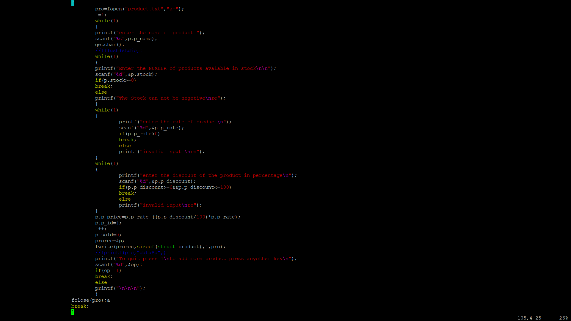
PRODUCT DETAIL FILE CREATION

Slide 10
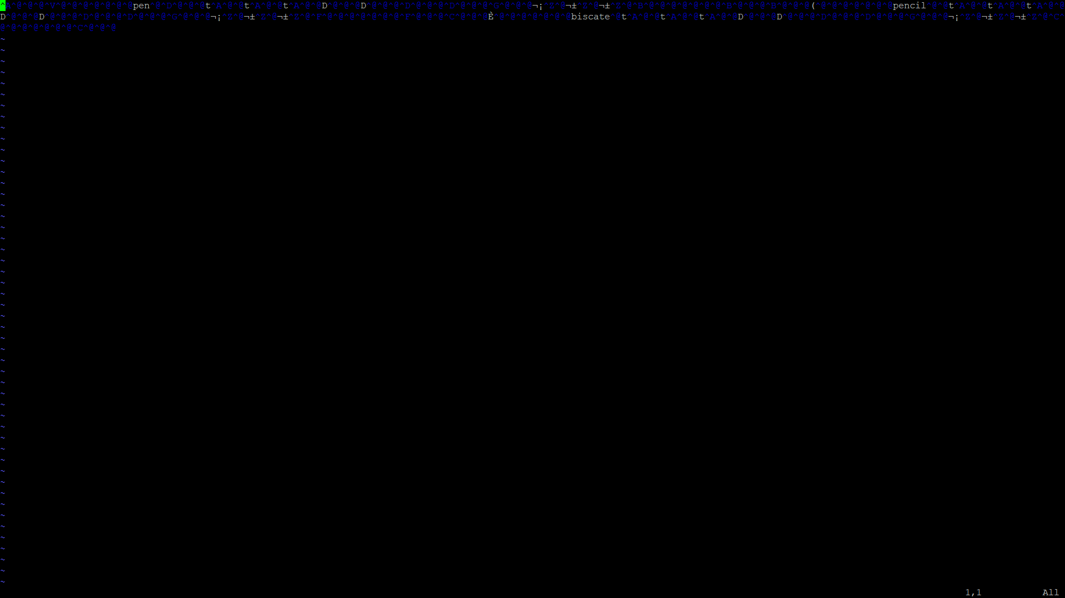
BINARY FILES

Slide 11
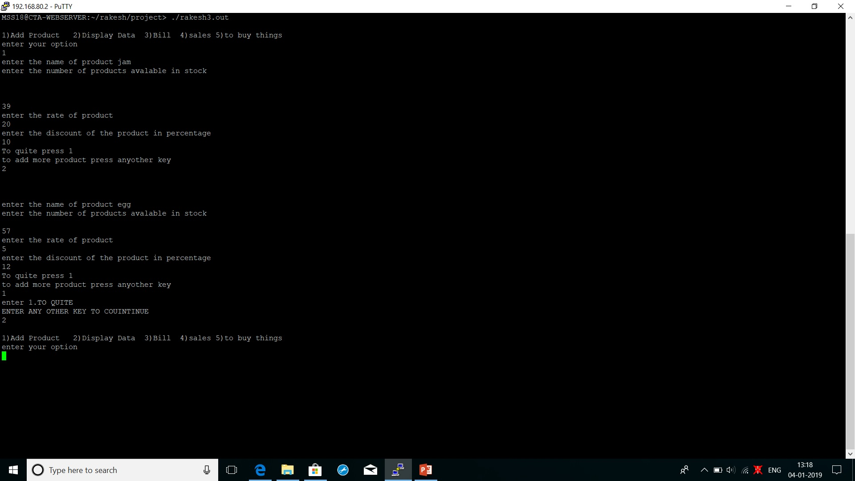
output

Slide 12
THINGS YET TO BE ADDED
HIGHEST AND LOWEST SOLD PRODUCT
ADD CUSTOMER DETAILS

Slide 13
THANK YOU

